Slide 1
BRACE Lifecycle & Risk Minimization Measures
Yasser Al-Ahmary
1 May 2023

Slide 2
Disclaimer
The view expressed in this lecture are those of the presenter and are not intended to convey official policy or guidance.
I am providing this lecture as a private individual and not as an affiliate with an employer, and as such, the principles, ideas, and perspectives provided during the lecture are my own not necessarily those of my employer.

Slide 3
Objectives of RMP
Identify or characterise the safety profile of the medicinal product concerned
Indicate the level of certainty that efficacy shown in Clinical trial populations will be seen in everyday medical practice and document the need for studies on efficacy in the post authorization phase
Plan how the effectiveness of risk minimization measures will be assessed

Slide 4
Terminology
Risk management system
A risk management system is a set of pharmacovigilance activities and interventions designed to identify, characterize, prevent or minimize risks relating to medicinal products, including the assessment of the effectiveness of those interventions
Risk management plan
A detailed description of the risk management system
Risk minimisation activity
An intervention intended to prevent or reduce the probability of the occurrence of an adverse reaction associated with the exposure to a medicine or to reduce its severity should it occur

Slide 5
RMP Concept
Safety Specification
Identify important safety concern
Identified Risks
Pharmacovigilance Plan
Find out further information about the important safety concerns
Risk Minimisation Plan
Potential Risks
Missing information
Interventions to mitigate risks of the medicinal products

Slide 6
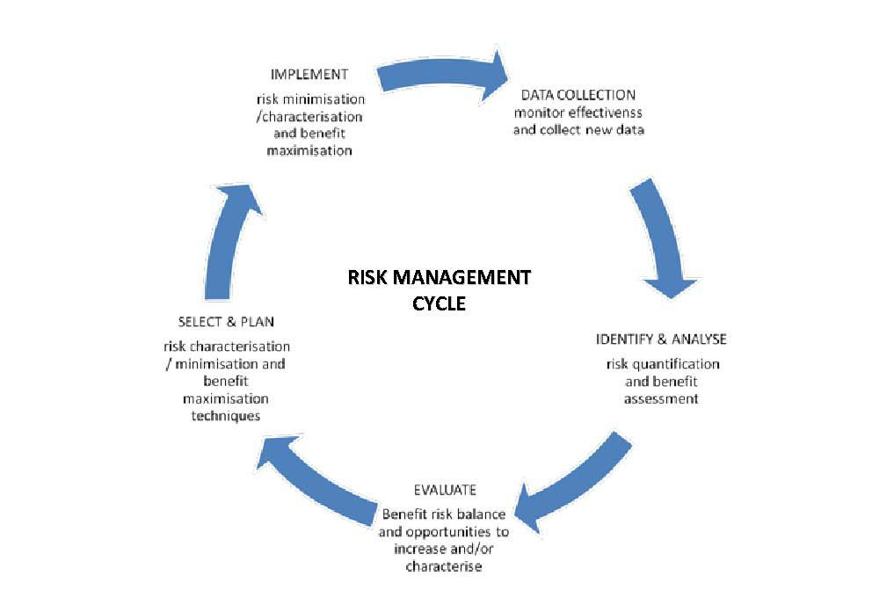
The Risk Management Cycle

Slide 7
Situations when a RMP should be submitted
For all new marketing applications
Situations, in addition, where RMP update will normally be expected include:
with an application involving a significant change to an existing marketing authorisation
New dosage form
New route of administration
New manufacturing process
Pediatric indication & other signifiant change
at the request of the Saudi FDA
with a submission of final study results or updates impacting the RMP

Slide 8
Addition of Saudi-Specific Annex (SSA)
The MAH must submit a SSA with any EU RMP (or Core/Global RMP where no current EU RMP exists) submitted. The only situation where an SSA is not routinely required is if the RMP has been prepared specifically for Saudi Arabia.
The Saudi specific annex (SSA) provides details that enable the EU RMP (or core /global RMP if no current EU RMP exists) to be adapted to the Saudi context.
Format and content of the SSA are described (V.B.10.9. RMP annex 9: Saudi-Specific Annex).

Slide 9
Submission of the RMP
For pre-authorized products, the RMP is submitted as PDF files within the eCTD/CTD submission or otherwise requested by the Saudi FDA.
For post authorization products, the RMP is submitted as PDF through Email or a CD with cover letter.

Slide 10
Risk Minimization Measures
Risk minimization measures are interventions intended to prevent or reduce the occurrence of adverse reactions associated with the exposure to a medicine, or to reduce their severity or impact on the patient should adverse reactions occur.
Planning and implementing risk minimisation measures and assessing their effectiveness are key elements of risk management
The MAH shall include all risk minimisation measures in the risk management plan and monitor their outcome

Slide 11
Risk Minimization Measures
Design
Evaluation
Implementation
Best practices
Practical
Empirically supported

Slide 12
Writing Clear Goals & Objectives
S
Specific
M
Measurable
A
R
Realistic
T
Achievable
Time-bound

Slide 13
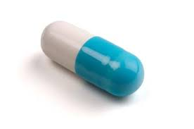
Example
Goal of risk minimization program for Product X:
To prevent a fatal drug-drug interaction when using Product X with other drug product.
Objectives:
To educate at least 90% of KSA-based prescribers and dispensing pharmacists about the risk of a fatal drug-drug interaction that is associated with use of Product X by December 31, 2023.
To educate 100% patients receiving Product X about this drug-drug interaction and to inform them that they should not take Product X with other drug product.

Slide 14
Be Stakeholder-Centered
Internal
Manufacturing
Drug Safety
External
Physicians
Pharmacists
Supply Chain
Legal
Commercial
Patients
Other HCPs
Regulatory
Clinical/Medical Affairs
Key Stakeholders

Slide 15
Risk Minimisation Tools
Education Tools
Educational materials
Written, sound, video, cards
Training
Reminders (Letter, alerts cards, check lists…)
Distribution
Legal status ( OTC, Rx…)
Hospital/speciality use only
Controlled distribution system

Slide 16
Additional risk minimisation activities
Health Care Professional Educational Programme
Dear Health Care Professional Letter
Physician’s or Pharmacist’s guide to prescribing
Checklist before prescribing/dispensing
Specific training program
Specific training program
Patient Alert Card
Patient Reminder Card
Patient Information Brochure/Booklet
Limited Prescription
Other

Slide 17
Core Implementation Strategy
Goals: To reduce medication errors with product X
Objective: To educate pharmacists in correct admixing instructions
Who? | What? | Tool | When ? | How?
Pharmacists | Education regarding key content: -Steps in admixing -Safe storage | Paper-based brochure Web-based app | At time of initial dispensing At each subsequent dispensing | Mail In-person delivery of hard copies by Sales Rep Via email

Slide 18
Key Take-Aways
Global harmonization of risk minimization with planned process, including adaptations, is possible
Advantageous:
Business: greater efficiency & effectiveness
Less burdensome to healthcare system, patients and healthcare professionals
Share our experiences to build best practices around implementation

Slide 19
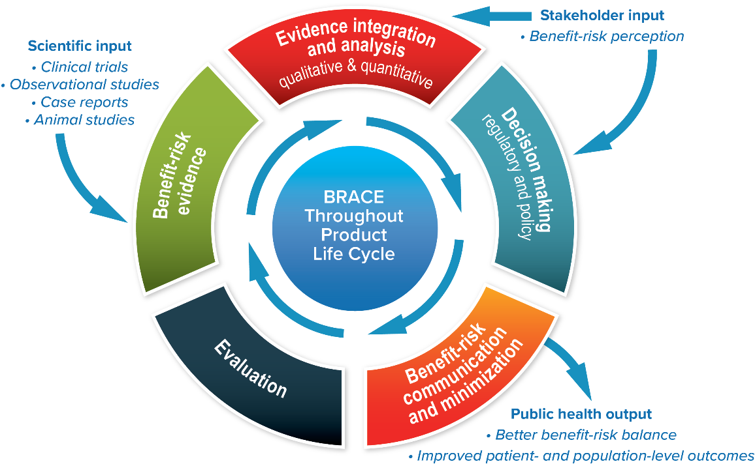
Evaluation of Risk Minimization Measures (RMM)
Benefit-Risk Assessment, Communication, and Evaluation (BRACE) Throughout the Life Cycle of Medicinal Products and Devices

Slide 20
Considerations When Evaluating the Effectiveness of Additional Risk Minimization Measures
Who is the audience of the risk minimization program?
What defines “effectiveness” of a risk minimization program?
When should effectiveness be evaluated?
How should effectiveness be measured?
Where can I find more information about evaluating risk minimization measures?

Slide 21
How Should Effectiveness be Measured?
PROCESS INDICATORS
“Process indicators are necessary to gather evidence that the implementing steps of additional risk minimisation measures have been successful. These process indicators should provide insight into what extent the programme has been executed as planned and whether the intended impacts on behaviour have been observed.” EMA Module XVI Rev 2
OUTCOME INDICATORS
“Outcome indicators provide an overall measure of the level of risk control that has been achieved with any risk minimisation measure in place.” EMA Module VI, Rev 2

Slide 22
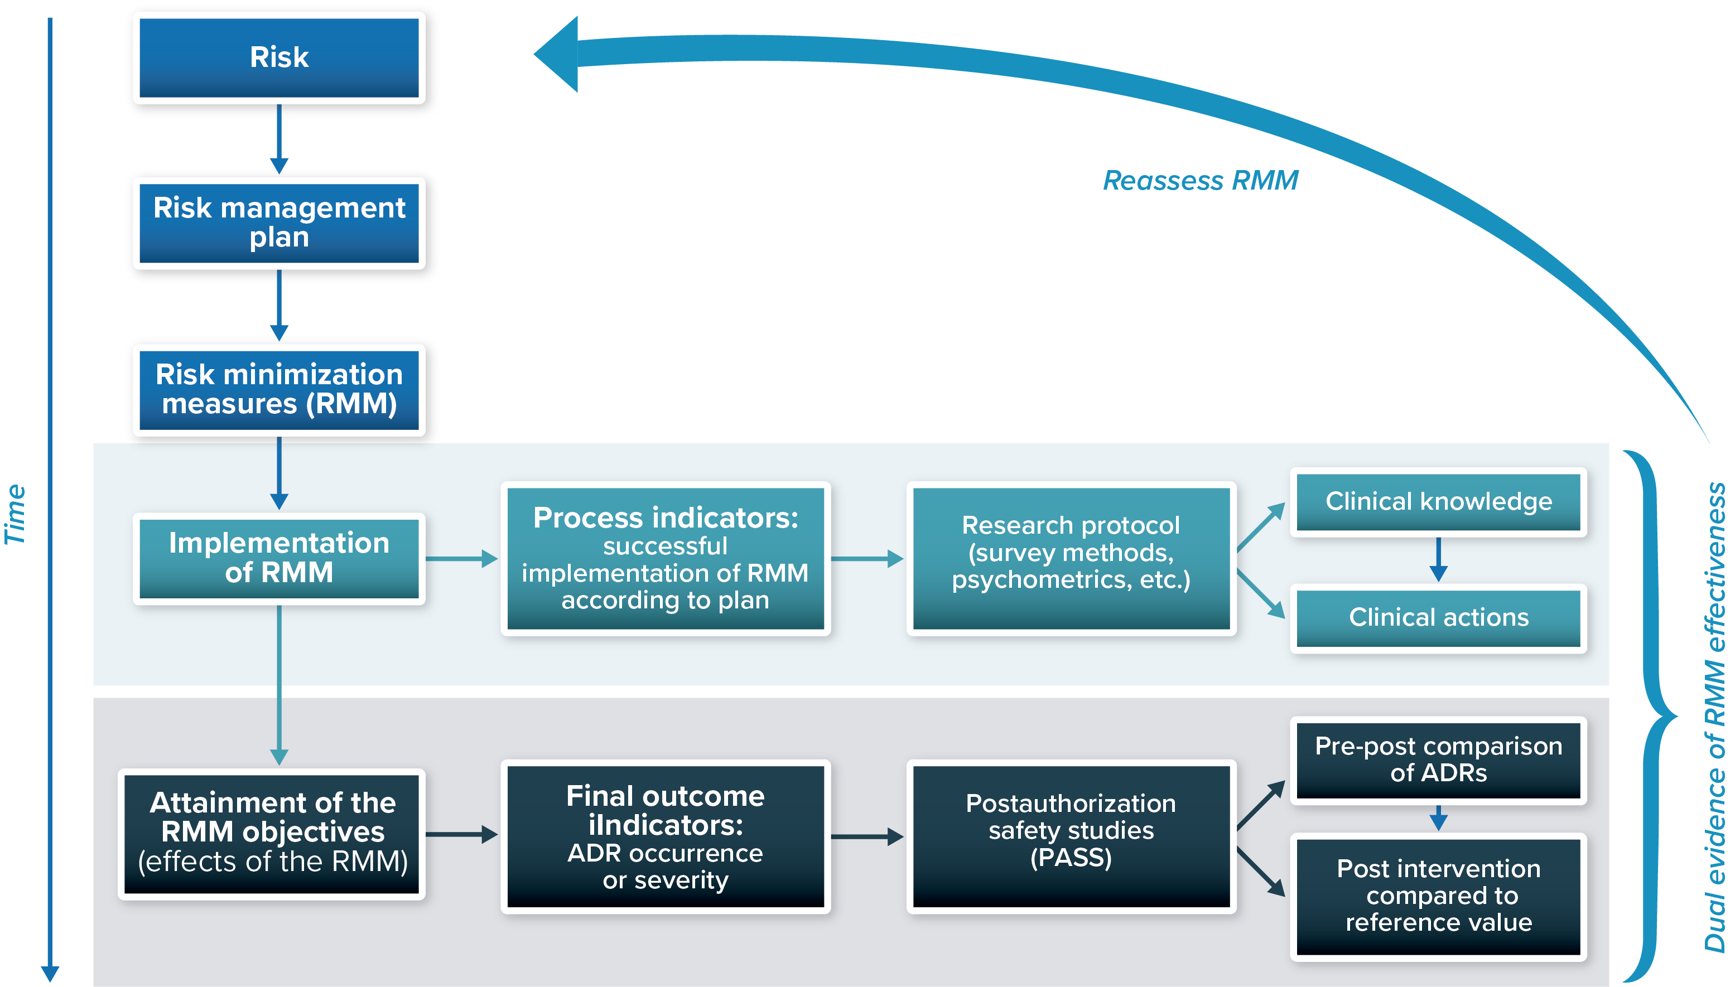
Assessing Process and Outcome Indicators
ADR = adverse drug reaction.
Source: Adapted from Prieto et al. Pharmacoepidemiol Drug Saf 2012:21(8):896-99

Slide 23
Important to note
Educational materials are one form of Risk minimization measures, and any educational programme should be completely separated from promotional activities
Contact information of physicians or patients gathered during the educational programmes should not be used for promotional activities
Additional risk minimization measures are proposed when routine measures are insufficient to address certain risks.
The Saudi FDA should approve the draft materials and proposed dissemination plan must be submitted for approval on a requested specific form. The dissemination report should be provided quarterly to the SFDA.

Slide 24
Distribution timelines as per the new GVP in Saudi Arabia
The MAH are requested to complete the distribution of Direct Healthcare Professional Communication (DHPC) letters within 60 days after its approval. An evidence of the distribution must be submitted after the completion of the distribution using the standardized form. If the DHPC is distributed electronically, the distribution process should be completed within 10 working days.
An evidence of the distribution process of Risk Minimization Measures other than DHPCs must be submitted quarterly, for the period of one year, using the standardized form. If the measures is distributed electronically, the distribution process should be completed within 10 working days.
After one year from starting the distribution process (i.e., after submitting four distribution reports), the MAH is no longer required to submit further distribution evidence. However, it is still the MAH’s responsibility to ensure that the RMMs are continuously available in enough amounts wherever the product is prescribed and dispensed. In addition, the MAH should submit the distribution evidence, when including institutions where the product is added recently and was not covered in the initial distribution plan.
RMMs shall not be removed or discontinued, unless the MAH updates the Risk Management plan (RMP) of the product and provides a rational for its removal.

Slide 25
New Trends for Risk Minimization Tools
Digital
Leverage a single distribution platform
Easier to distribute, update, and re-version
Enables use of more effective learning techniques (e.g., interactivity, tailoring, practice via repetition, human motivation to compete)

Slide 26


